Slide 1
Metaball Study

Slide 2
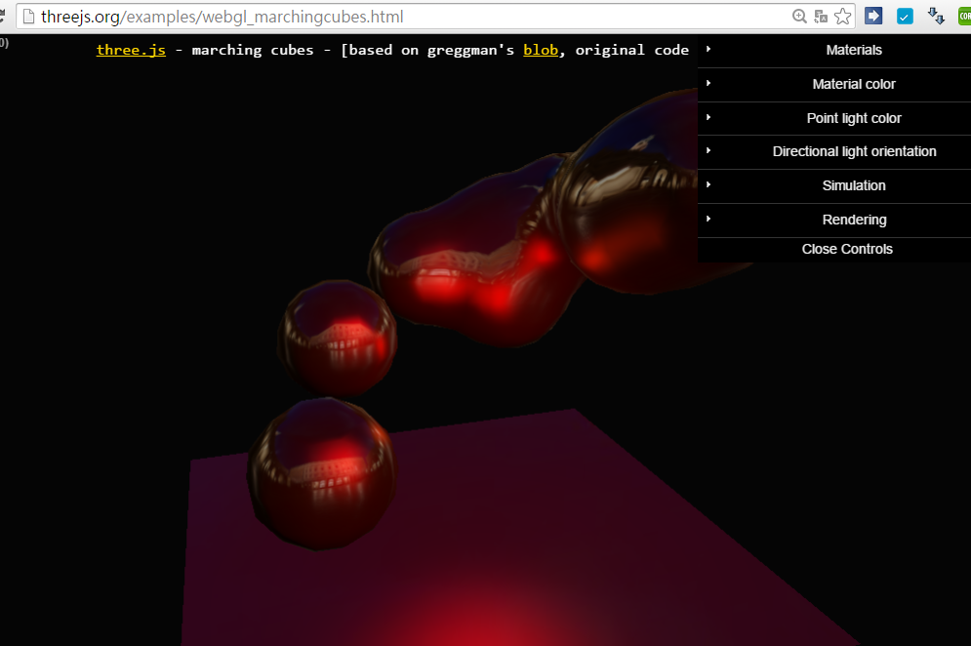
Official ThreeJS + MarchingCube Example

Slide 3
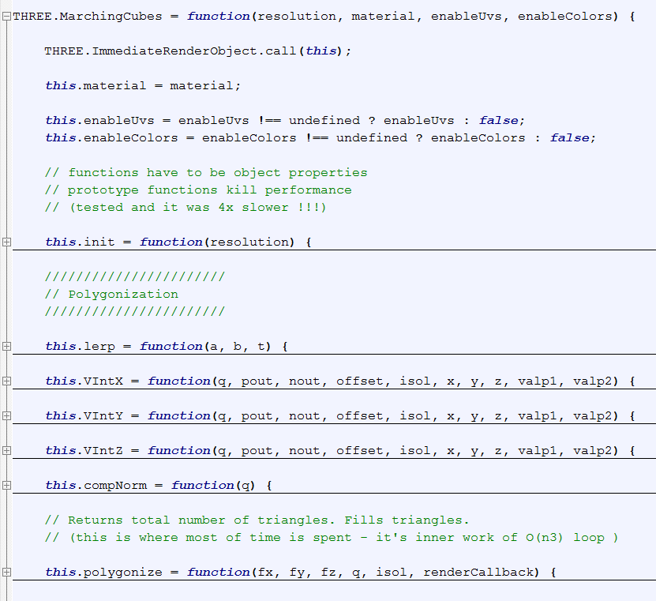
MarchingCube Class

Slide 4
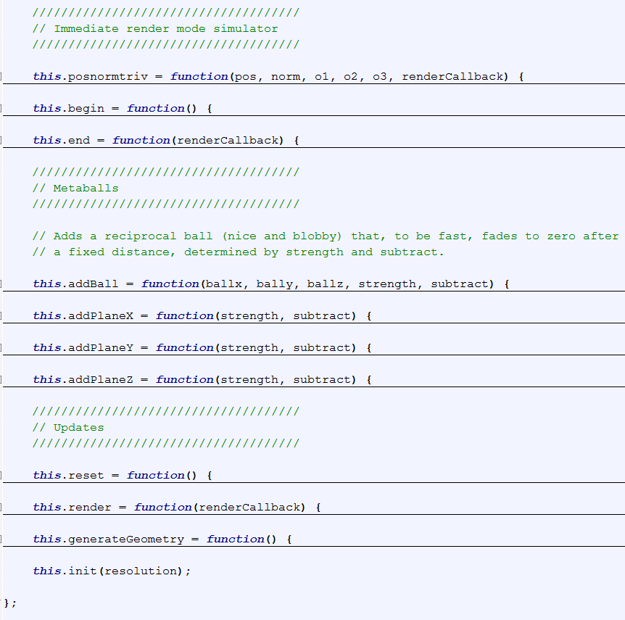

Slide 5
Constructor
this.init (resolution)
Size = resolution (max: 32, practically)
Size3 = size*size*size
Field = new Float32Array (size3);
Normal_cache = new Float32Array (size3*3);

Slide 6
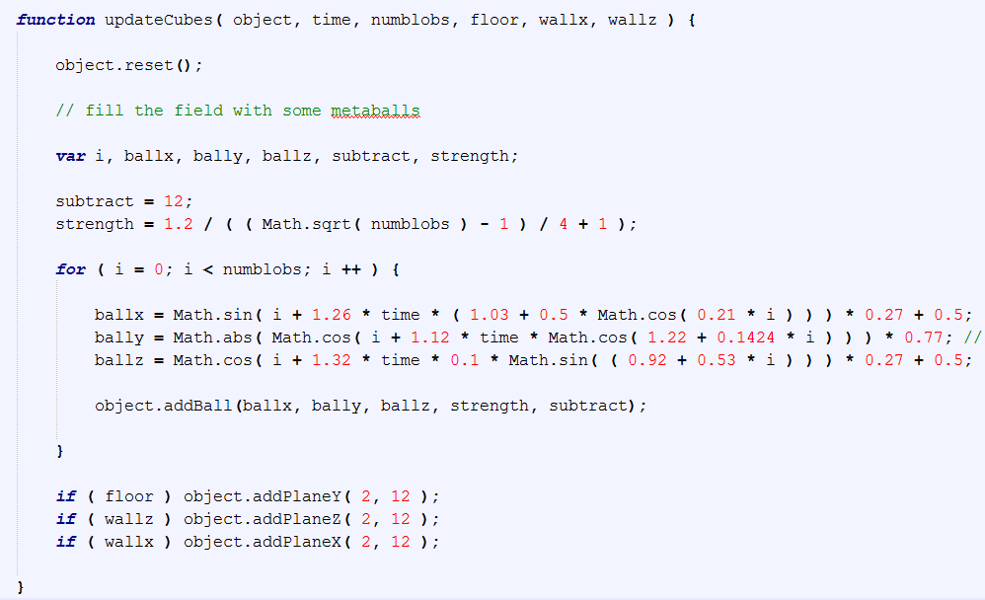
In Calling Program
[0.23, 0.77]^3

Slide 7
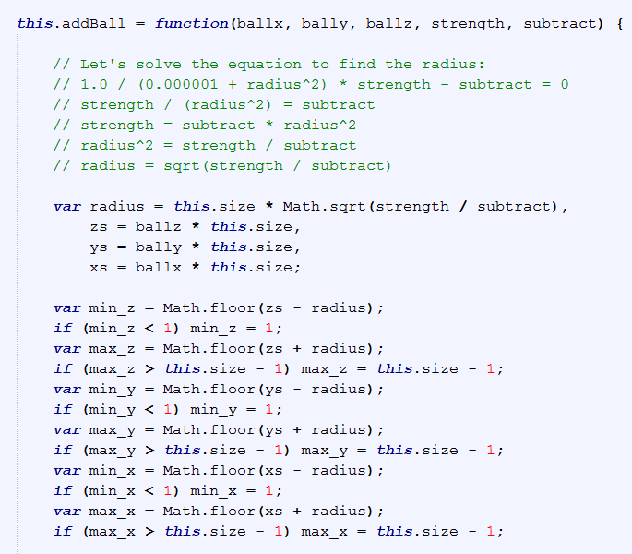
Metaball Details
In normalized scale, multiplied by size (i.e., resolution)
Range of ball
[min_xyz, max_xyz],
all integers
Max. range:
[1, this.size – 1]^3

Slide 8
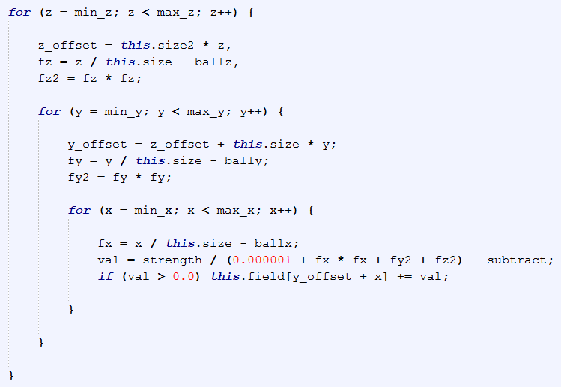
Only modify the field value within
[min_x, max_x] x [min_y, max_y] x [min_z, max_z]
Back to normalized scale
y_offset, z_offset:
help to access the triple array [x][y][z]

Slide 9
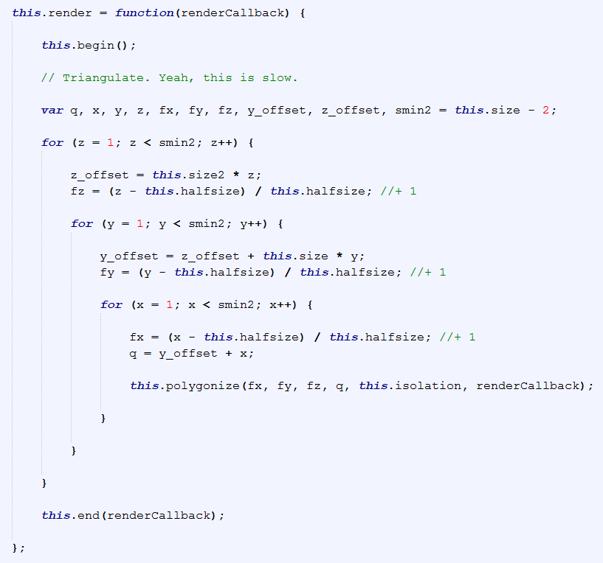
Render
1.0

Slide 10
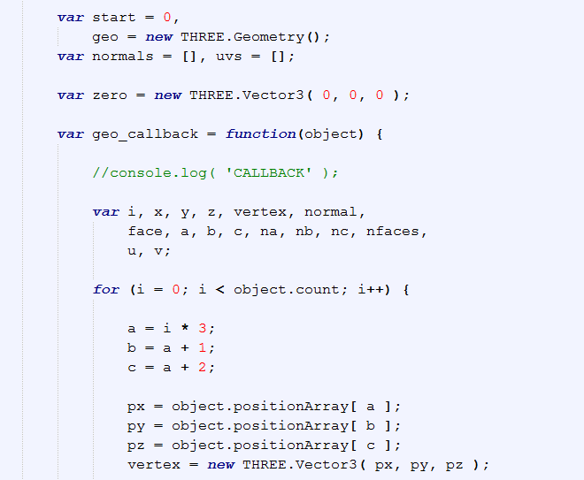
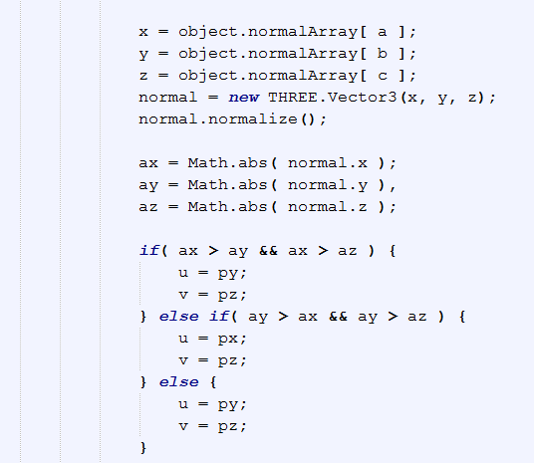
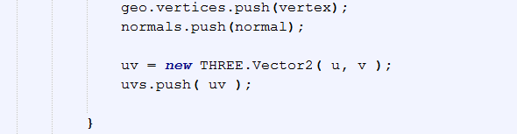

Slide 11
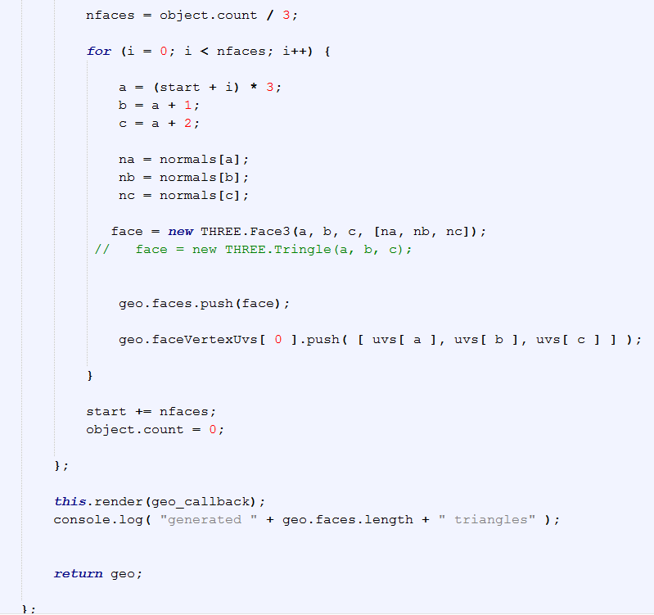

Slide 12
Comments
Marchingcube.js, Mr. Doobs
https://github.com/mrdoob/three.js/blob/dev/examples/js/MarchingCubes.js
Use ImmediateRenderObject call
Lookup table
EdgeTable, TriTable (from Paul Bourke’s page)
JavaScript Int32Array

Slide 13
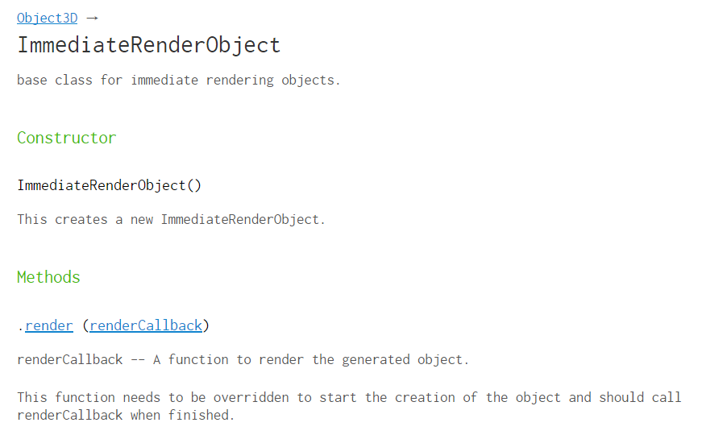

Slide 14

Test run

Slide 15
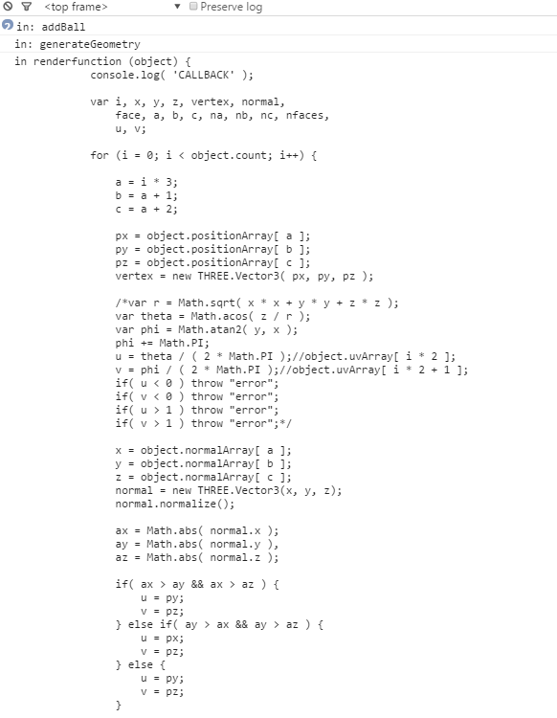

Slide 16
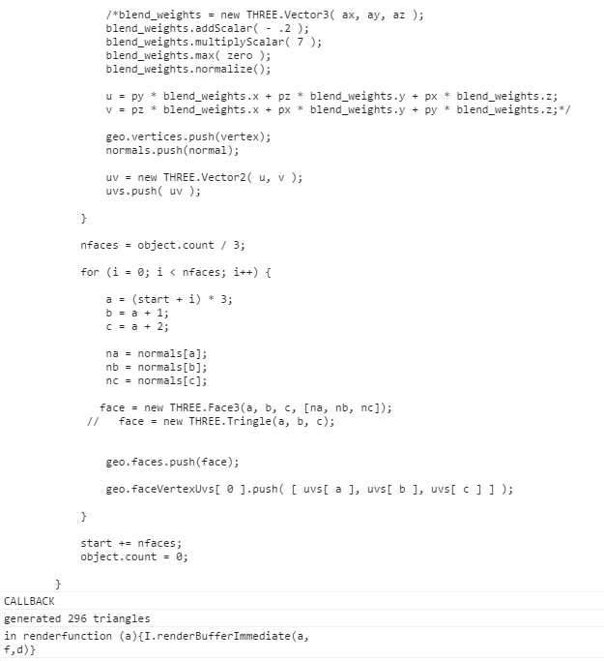

Slide 17
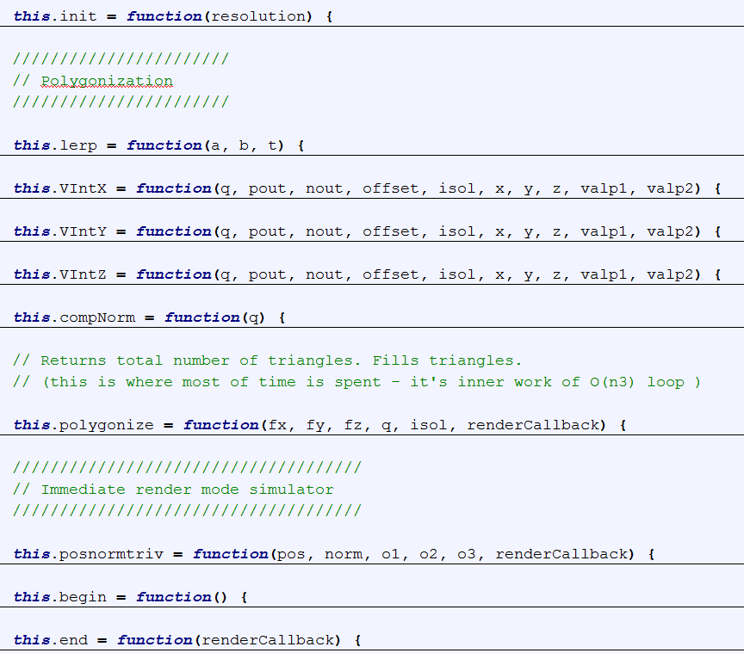

Slide 18
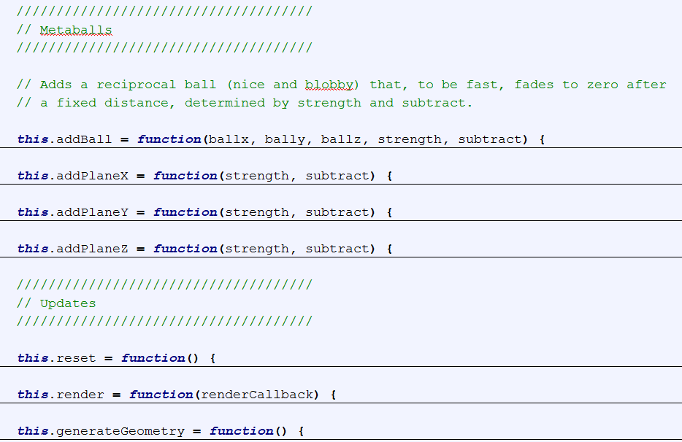
Clear cache
Calls polygonise: the real stuff
Can produce three.js geometry?!

Slide 19
